Slide 1
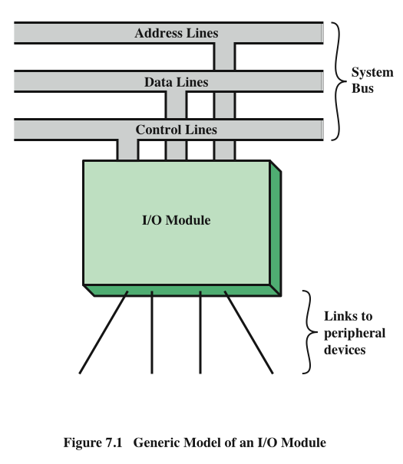
Generic
Model of an I/O Module
Notes:
Thus, an I/O module is required. This module has two major functions
(Figure 7.1):
• Interface to the processor and memory via the system bus or central switch
• Interface to one or more peripheral devices by tailored data links
We begin this chapter with a brief discussion of external devices, followed by
an overview of the structure and function of an I/O module. Then we look at the
various ways in which the I/O function can be performed in cooperation with the
processor and memory: the internal I/O interface. Finally, we examine the external
I/O interface, between the I/O module and the outside world.

Slide 2
External Devices
Provide a means of exchanging data between the external environment and the computer
Attach to the computer by a link to an I/O module
  The link is used to exchange control, status, and data between the I/O module and the external device
peripheral device
  An external device connected to an I/O module
Three categories:
Human readable
  Suitable for communicating with the computer user
  Video display terminals (VDTs), printers
Machine readable
  Suitable for communicating with equipment
  Magnetic disk and tape systems, sensors and actuators
Communication
  Suitable for communicating with remote devices such as a terminal, a machine readable device, or another computer
Notes:
I/O operations are accomplished through a wide assortment of external devices
that provide a means of exchanging data between the external environment
and the computer. An external device attaches to the computer by a link to
an I/O module (Figure 7.1). The link is used to exchange control, status, and
data between the I/O module and the external device. An external device connected
to an I/O module is often referred to as a peripheral device or, simply, a
peripheral.
We can broadly classify external devices into three categories:
• Human readable: Suitable for communicating with the computer user
• Machine readable: Suitable for communicating with equipment
• Communication: Suitable for communicating with remote devices
Examples of human-readable devices are video display terminals (VDTs) and
printers. Examples of machine-readable devices are magnetic disk and tape systems,
and sensors and actuators, such as are used in a robotics application. Note
that we are viewing disk and tape systems as I/O devices in this chapter, whereas
in Chapter 6 we viewed them as memory devices. From a functional point of view,
these devices are part of the memory hierarchy, and their use is appropriately discussed
in Chapter 6. From a structural point of view, these devices are controlled by
I/O modules and are hence to be considered in this chapter.
Communication devices allow a computer to exchange data with a remote
device, which may be a human-readable device, such as a terminal, a machine readable
device, or even another computer.

Slide 3
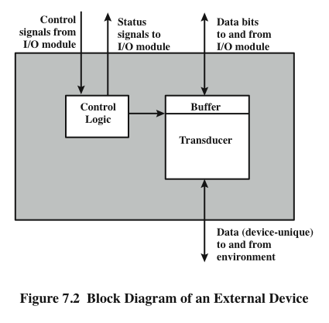
External
Device
Block
Diagram
Notes:
In very general terms, the nature of an external device is indicated in
Figure 7.2. The interface to the I/O module is in the form of control, data, and status
signals. Control signals determine the function that the device will perform, such as
send data to the I/O module (INPUT or READ), accept data from the I/O module
(OUTPUT or WRITE), report status, or perform some control function particular
to the device (e.g., position a disk head). Data are in the form of a set of bits to
be sent to or received from the I/O module. Status signals indicate the state of the
device. Examples are READY/NOT-READY to show whether the device is ready
for data transfer.
Control logic associated with the device controls the device’s operation in
response to direction from the I/O module. The transducer converts data from electrical
to other forms of energy during output and from other forms to electrical during
input. Typically, a buffer is associated with the transducer to temporarily hold
data being transferred between the I/O module and the external environment; a
buffer size of 8 to 16 bits is common.

Slide 4
Keyboard/Monitor
Most common means of computer/user interaction
User provides input through the keyboard
The monitor displays data provided by the computer
International Reference Alphabet (IRA)
Keyboard Codes
Basic unit of exchange is the character
  Associated with each character is a code
  Each character in this code is represented by a unique 7-bit binary code
    128 different characters can be represented
Characters are of two types:
  Printable
    Alphabetic, numeric, and special characters that can be printed on paper or displayed on a screen
  Control
    Have to do with controlling the printing or displaying of characters
    Example is carriage return
    Other control characters are concerned with communications procedures
When the user depresses a key it generates an electronic signal that is interpreted by the transducer in the keyboard and translated into the bit pattern of the corresponding IRA code
This bit pattern is transmitted to the I/O module in the computer
On output, IRA code characters are transmitted to an external device from the I/O module
The transducer interprets the code and sends the required electronic signals to the output device either to display the indicated character or perform the requested control function
Notes:
The most common means of computer/user interaction is a keyboard/monitor
arrangement. The user provides input through the keyboard. This input is then
transmitted to the computer and may also be displayed on the monitor. In addition,
the monitor displays data provided by the computer.
The basic unit of exchange is the character. Associated with each character
is a code, typically 7 or 8 bits in length. The most commonly used text code is the
International Reference Alphabet (IRA). Each character in this code is represented
by a unique 7-bit binary code; thus, 128 different characters can be represented.
Characters are of two types: printable and control. Printable characters are
the alphabetic, numeric, and special characters that can be printed on paper or displayed
on a screen. Some of the control characters have to do with controlling the
printing or displaying of characters; an example is carriage return. Other control
characters are concerned with communications procedures. See Appendix F for
details.
For keyboard input, when the user depresses a key, this generates an
electronic signal that is interpreted by the transducer in the keyboard and
translated into the bit pattern of the corresponding IRA code. This bit pattern
is then transmitted to the I/O module in the computer. At the computer, the
text can be stored in the same IRA code. On output, IRA code characters are
transmitted to an external device from the I/O module. The transducer at the
device interprets this code and sends the required electronic signals to the output
device either to display the indicated character or perform the requested
control function.

Slide 5
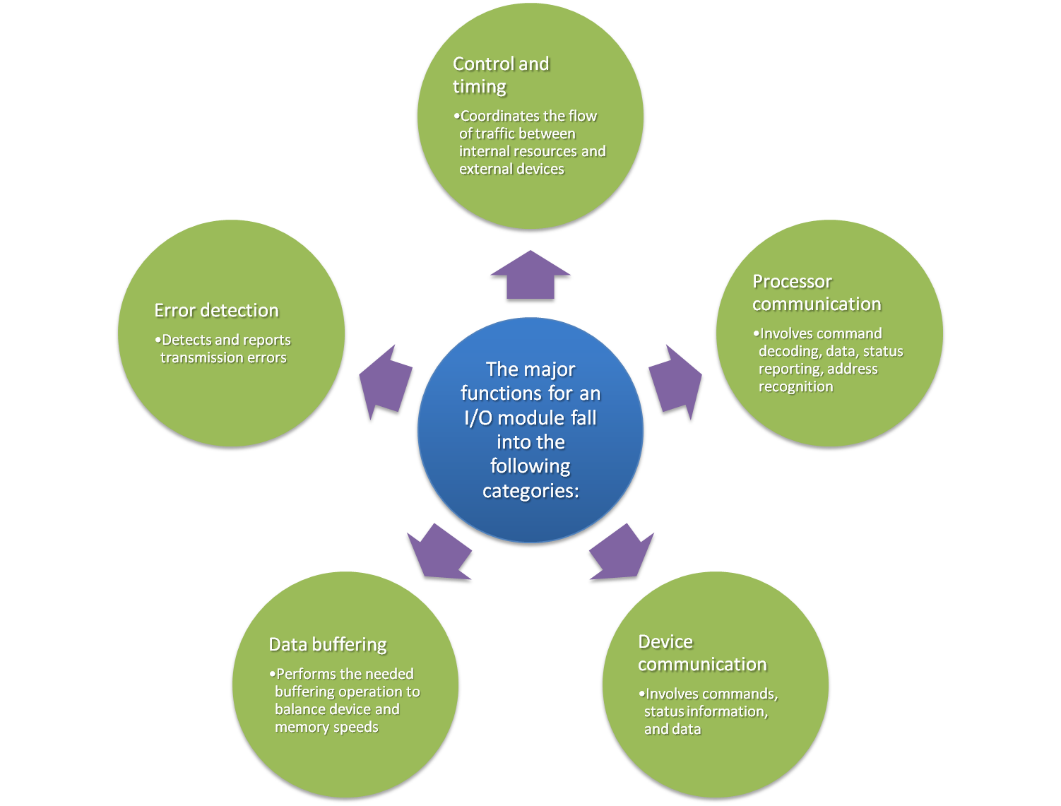
I/O Modules
Module Function
Notes:
The major functions or requirements for an I/O module fall into the following
categories:
• Control and timing
• Processor communication
• Device communication
• Data buffering
• Error detection
During any period of time, the processor may communicate with one or more
external devices in unpredictable patterns, depending on the program’s need for I/O.
The internal resources, such as main memory and the system bus, must be shared
among a number of activities, including data I/O. Thus, the I/O function includes a
control and timing requirement, to coordinate the flow of traffic between internal
resources and external devices. For example, the control of the transfer of data from
an external device to the processor might involve the following sequence of steps:
1. The processor interrogates the I/O module to check the status of the attached
device.
2. The I/O module returns the device status.
3. If the device is operational and ready to transmit, the processor requests the
transfer of data, by means of a command to the I/O module.
4. The I/O module obtains a unit of data (e.g., 8 or 16 bits) from the external device.
5. The data are transferred from the I/O module to the processor.
If the system employs a bus, then each of the interactions between the processor
and the I/O module involves one or more bus arbitrations.
The preceding simplified scenario also illustrates that the I/O module must
communicate with the processor and with the external device. Processor communication
involves the following:
• Command decoding: The I/O module accepts commands from the processor,
typically sent as signals on the control bus. For example, an I/O module for a
disk drive might accept the following commands: READ SECTOR, WRITE
SECTOR, SEEK track number, and SCAN record ID. The latter two commands
each include a parameter that is sent on the data bus.
• Data: Data are exchanged between the processor and the I/O module over the
data bus.
• Status reporting: Because peripherals are so slow, it is important to know the
status of the I/O module. For example, if an I/O module is asked to send data
to the processor (read), it may not be ready to do so because it is still working
on the previous I/O command. This fact can be reported with a status signal.
Common status signals are BUSY and READY. There may also be signals to
report various error conditions.
• Address recognition: Just as each word of memory has an address, so does
each I/O device. Thus, an I/O module must recognize one unique address for
each peripheral it controls.
On the other side, the I/O module must be able to perform device communication.
This communication involves commands, status information, and data
(Figure 7.2).
An essential task of an I/O module is data buffering. The need for this function
is apparent from Figure 2.11. Whereas the transfer rate into and out of main
memory or the processor is quite high, the rate is orders of magnitude lower for
many peripheral devices and covers a wide range. Data coming from main memory
are sent to an I/O module in a rapid burst. The data are buffered in the I/O module
and then sent to the peripheral device at its data rate. In the opposite direction, data
are buffered so as not to tie up the memory in a slow transfer operation. Thus, the
I/O module must be able to operate at both device and memory speeds. Similarly, if
the I/O device operates at a rate higher than the memory access rate, then the I/O
module performs the needed buffering operation.
Finally, an I/O module is often responsible for error detection and for subsequently
reporting errors to the processor. One class of errors includes mechanical
and electrical malfunctions reported by the device (e.g., paper jam, bad disk track).
Another class consists of unintentional changes to the bit pattern as it is transmitted
from device to I/O module. Some form of error-detecting code is often used
to detect transmission errors. A simple example is the use of a parity bit on each
character of data. For example, the IRA character code occupies 7 bits of a byte.
The eighth bit is set so that the total number of 1s in the byte is even (even parity)
or odd (odd parity). When a byte is received, the I/O module checks the parity to
determine whether an error has occurred.

Slide 6
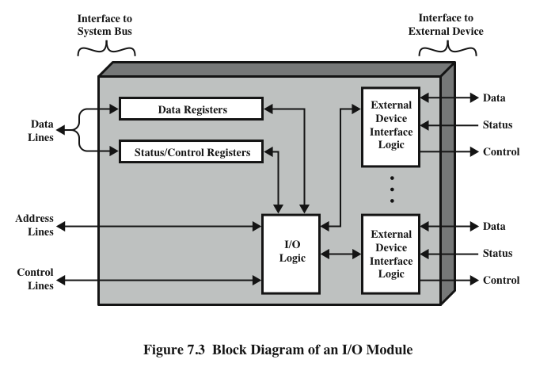
I/O Module Structure
Notes:
I/O modules vary considerably in complexity and the number of external devices
that they control. We will attempt only a very general description here. (One specific
device, the Intel 82C55A, is described in Section 7.4.) Figure 7.3 provides a general
block diagram of an I/O module. The module connects to the rest of the computer
through a set of signal lines (e.g., system bus lines). Data transferred to and from the
module are buffered in one or more data registers. There may also be one or more
status registers that provide current status information. A status register may also
function as a control register, to accept detailed control information from the processor.
The logic within the module interacts with the processor via a set of control
lines. The processor uses the control lines to issue commands to the I/O module.
Some of the control lines may be used by the I/O module (e.g., for arbitration and
status signals). The module must also be able to recognize and generate addresses
associated with the devices it controls. Each I/O module has a unique address or, if
it controls more than one external device, a unique set of addresses. Finally, the I/O
module contains logic specific to the interface with each device that it controls.
An I/O module functions to allow the processor to view a wide range of devices
in a simple-minded way. There is a spectrum of capabilities that may be provided.
The I/O module may hide the details of timing, formats, and the electromechanics
of an external device so that the processor can function in terms of simple read and
write commands, and possibly open and close file commands. In its simplest form,
the I/O module may still leave much of the work of controlling a device (e.g., rewind
a tape) visible to the processor.
An I/O module that takes on most of the detailed processing burden, presenting
a high-level interface to the processor, is usually referred to as an I/O channel or
I/O processor. An I/O module that is quite primitive and requires detailed control
is usually referred to as an I/O controller or device controller. I/O controllers are
commonly seen on microcomputers, whereas I/O channels are used on mainframes.
In what follows, we will use the generic term I/O module when no confusion
results and will use more specific terms where necessary.

Slide 7
Programmed I/O
Three techniques are possible for I/O operations:
Programmed I/O
  Data are exchanged between the processor and the I/O module
  Processor executes a program that gives it direct control of the I/O operation
  When the processor issues a command it must wait until the I/O operation is complete
  If the processor is faster than the I/O module this is wasteful of processor time
  Interrupt-driven I/O
  Processor issues an I/O command, continues to execute other instructions, and is interrupted by the I/O module when the latter has completed its work
  Direct memory access (DMA)
  The I/O module and main memory exchange data directly without processor involvement
Notes:
Three techniques are possible for I/O operations. With programmed I/O, data are
exchanged between the processor and the I/O module. The processor executes a program
that gives it direct control of the I/O operation, including sensing device status,
sending a read or write command, and transferring the data. When the processor
issues a command to the I/O module, it must wait until the I/O operation is complete.
If the processor is faster than the I/O module, this is wasteful of processor time.
With interrupt-driven I/O, the processor issues an I/O command, continues to execute
other instructions, and is interrupted by the I/O module when the latter has completed
its work. With both programmed and interrupt I/O, the processor is responsible for
extracting data from main memory for output and storing data in main memory for
input. The alternative is known as direct memory access (DMA). In this mode, the I/O
module and main memory exchange data directly, without processor involvement.

Slide 8
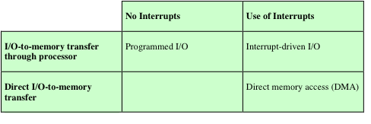
Table 7.1
I/O Techniques
Notes:
Table 7.1 indicates the relationship among these three techniques. In this section,
we explore programmed I/O. Interrupt I/O and DMA are explored in the following
two sections, respectively.

Slide 9
I/O Commands
There are four types of I/O commands that an I/O module may receive when it is addressed by a processor:
Control
  - used to activate a peripheral and tell it what to do
Test
  - used to test various status conditions associated with an I/O module and its peripherals
Read
  - causes the I/O module to obtain an item of data from the peripheral and place it in an internal buffer
Write
  - causes the I/O module to take an item of data from the data bus and subsequently transmit that data item to the peripheral
Notes:
To execute an I/O-related instruction, the processor issues an address, specifying the
particular I/O module and external device, and an I/O command. There are four types
of I/O commands that an I/O module may receive when it is addressed by a processor:
• Control: Used to activate a peripheral and tell it what to do. For example, a
magnetic-tape unit may be instructed to rewind or to move forward one record.
These commands are tailored to the particular type of peripheral device.
• Test: Used to test various status conditions associated with an I/O module and
its peripherals. The processor will want to know that the peripheral of interest
is powered on and available for use. It will also want to know if the most
recent I/O operation is completed and if any errors occurred.
• Read: Causes the I/O module to obtain an item of data from the peripheral
and place it in an internal buffer (depicted as a data register in Figure 7.3). The
processor can then obtain the data item by requesting that the I/O module
place it on the data bus.
• Write: Causes the I/O module to take an item of data (byte or word) from the
data bus and subsequently transmit that data item to the peripheral.

Slide 10
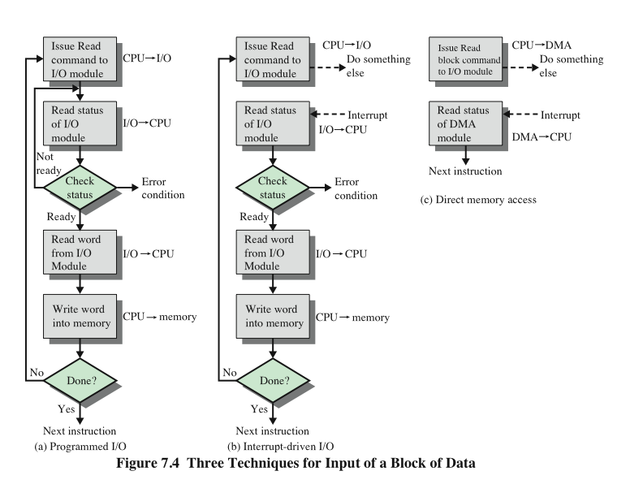
Three
Techniques for Input of a
Block of Data
Notes:
Figure 7.4a gives an example of the use of programmed I/O to read in a block of
data from a peripheral device (e.g., a record from tape) into memory. Data are read
in one word (e.g., 16 bits) at a time. For each word that is read in, the processor must
remain in a status-checking cycle until it determines that the word is available in the
I/O module’s data register. This flowchart highlights the main disadvantage of this
technique: it is a time-consuming process that keeps the processor busy needlessly.

Slide 11
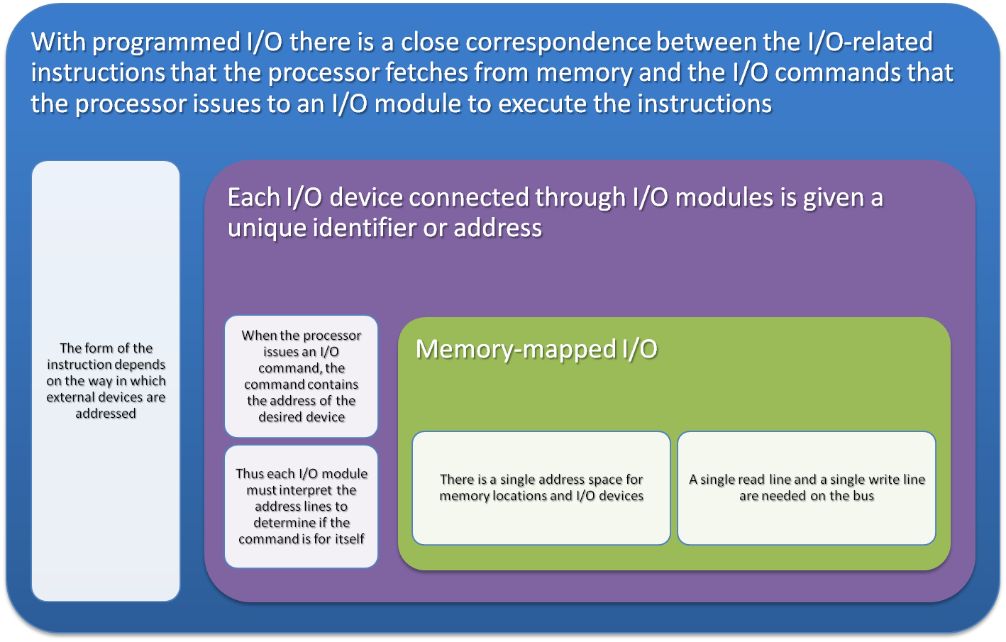
I/O Instructions
Notes:
With programmed I/O, there is a close correspondence between the I/O-related
instructions that the processor fetches from memory and the I/O commands that the
processor issues to an I/O module to execute the instructions. That is, the instructions
are easily mapped into I/O commands, and there is often a simple one-
to-one relationship. The form of the instruction depends on the way in which external
devices are addressed.
Typically, there will be many I/O devices connected through I/O modules to
the system. Each device is given a unique identifier or address. When the processor
issues an I/O command, the command contains the address of the desired device.
Thus, each I/O module must interpret the address lines to determine if the command
is for itself.
When the processor, main memory, and I/O share a common bus, two modes
of addressing are possible: memory mapped and isolated. With memory-mapped
I/O, there is a single address space for memory locations and I/O devices. The processor
treats the status and data registers of I/O modules as memory locations and
uses the same machine instructions to access both memory and I/O devices. So, for
example, with 10 address lines, a combined total of 2¹⁰ = 1024 memory locations
and I/O addresses can be supported, in any combination.
With memory-mapped I/O, a single read line and a single write line are needed
on the bus. Alternatively, the bus may be equipped with memory read and write
plus input and output command lines. Now, the command line specifies whether the
address refers to a memory location or an I/O device. The full range of addresses
may be available for both. Again, with 10 address lines, the system may now support
both 1024 memory locations and 1024 I/O addresses. Because the address space for
I/O is isolated from that for memory, this is referred to as isolated I/O.

Slide 12
I/O Mapping Summary
Memory mapped I/O
  Devices and memory share an address space
  I/O looks just like memory read/write
  No special commands for I/O
    Large selection of memory access commands available
Isolated I/O
  Separate address spaces
  Need I/O or memory select lines
  Special commands for I/O
    Limited set
Notes:
I/O mapping summary.

Slide 13
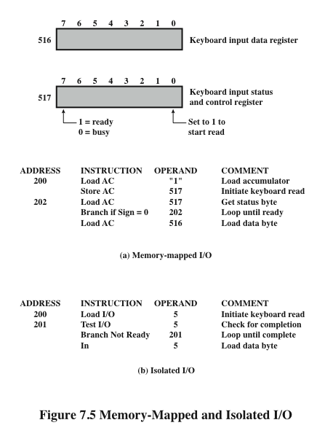
Memory
Mapped
I/O
Isolated
I/O
Notes:
Figure 7.5 contrasts these two programmed I/O techniques. Figure 7.5a shows
how the interface for a simple input device such as a terminal keyboard might appear
to a programmer using memory-mapped I/O. Assume a 10-bit address, with a 512-
bit memory (locations 0–511) and up to 512 I/O addresses (locations 512–1023).
Two addresses are dedicated to keyboard input from a particular terminal. Address
516 refers to the data register and address 517 refers to the status register, which
also functions as a control register for receiving processor commands. The program
shown will read 1 byte of data from the keyboard into an accumulator register in the
processor. Note that the processor loops until the data byte is available.
With isolated I/O (Figure 7.5b), the I/O ports are accessible only by special
I/O commands, which activate the I/O command lines on the bus.
For most types of processors, there is a relatively large set of different instructions
for referencing memory. If isolated I/O is used, there are only a few I/O
instructions. Thus, an advantage of memory-mapped I/O is that this large repertoire
of instructions can be used, allowing more efficient programming. A disadvantage is
that valuable memory address space is used up. Both memory-mapped and isolated
I/O are in common use.

Slide 14
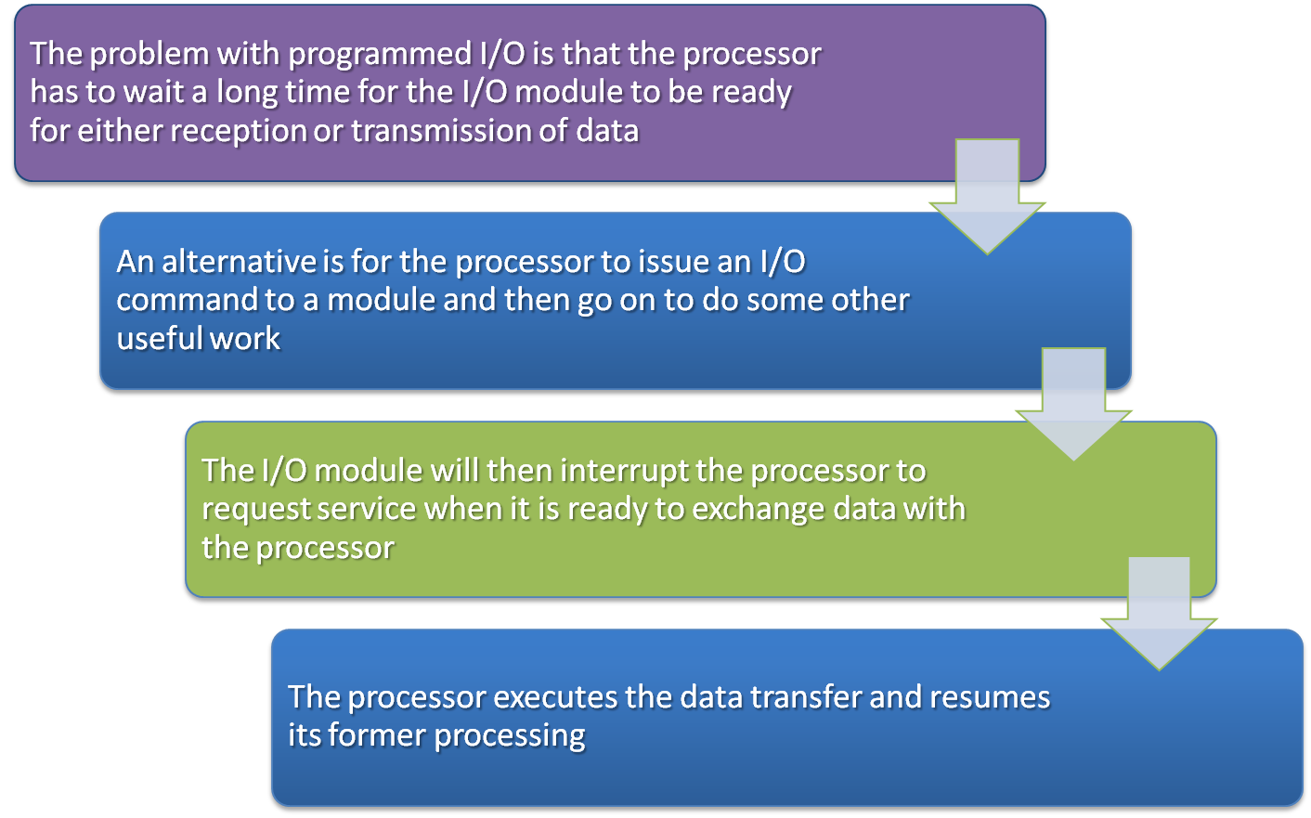
Interrupt-Driven I/O
Notes:
The problem with programmed I/O is that the processor has to wait a long time
for the I/O module of concern to be ready for either reception or transmission of
data. The processor, while waiting, must repeatedly interrogate the status of the I/O
module. As a result, the level of the performance of the entire system is severely
degraded.
An alternative is for the processor to issue an I/O command to a module and
then go on to do some other useful work. The I/O module will then interrupt the
processor to request service when it is ready to exchange data with the processor.
The processor then executes the data transfer, as before, and then resumes its
former processing.
Let us consider how this works, first from the point of view of the I/O module.
For input, the I/O module receives a READ command from the processor. The I/O
module then proceeds to read data in from an associated peripheral. Once the data
are in the module’s data register, the module signals an interrupt to the processor
over a control line. The module then waits until its data are requested by the processor.
When the request is made, the module places its data on the data bus and is
then ready for another I/O operation.
From the processor’s point of view, the action for input is as follows. The processor
issues a READ command. It then goes off and does something else (e.g., the
processor may be working on several different programs at the same time). At the
end of each instruction cycle, the processor checks for interrupts (Figure 3.9). When
the interrupt from the I/O module occurs, the processor saves the context (e.g., program
counter and processor registers) of the current program and processes the
interrupt. In this case, the processor reads the word of data from the I/O module
and stores it in memory. It then restores the context of the program it was working
on (or some other program) and resumes execution.
Figure 7.4b shows the use of interrupt I/O for reading in a block of data.
Compare this with Figure 7.4a. Interrupt I/O is more efficient than programmed I/O
because it eliminates needless waiting. However, interrupt I/O still consumes a lot of
processor time, because every word of data that goes from memory to I/O module
or from I/O module to memory must pass through the processor.

Slide 15
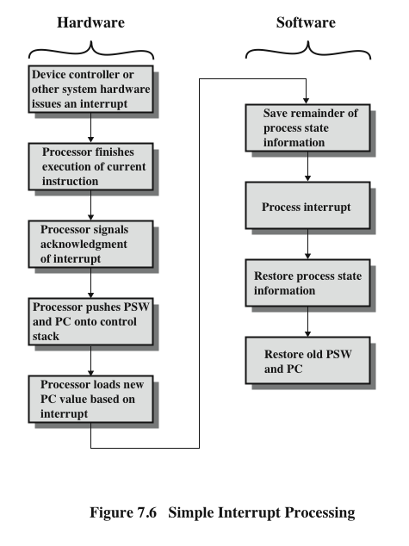
Simple Interrupt Processing
Notes:
Let us consider the role of the processor in interrupt-driven I/O in more detail.
The occurrence of an interrupt triggers a number of events, both in the processor
hardware and in software. Figure 7.6 shows a typical sequence. When an I/O device
completes an I/O operation, the following sequence of hardware events occurs:
1. The device issues an interrupt signal to the processor.
2. The processor finishes execution of the current instruction before responding
to the interrupt, as indicated in Figure 3.9.
3. The processor tests for an interrupt, determines that there is one, and sends an
acknowledgment signal to the device that issued the interrupt. The acknowledgment
allows the device to remove its interrupt signal.
4. The processor now needs to prepare to transfer control to the interrupt routine.
To begin, it needs to save information needed to resume the current program at
the point of interrupt. The minimum information required is (a) the status of the
processor, which is contained in a register called the program status word (PSW),
and (b) the location of the next instruction to be executed, which is contained in
the program counter. These can be pushed onto the system control stack.
5. The processor now loads the program counter with the entry location of the
interrupt-handling program that will respond to this interrupt. Depending on
the computer architecture and operating system design, there may be a single
program; one program for each type of interrupt; or one program for each
device and each type of interrupt. If there is more than one interrupt-handling
routine, the processor must determine which one to invoke. This information
may have been included in the original interrupt signal, or the processor may
have to issue a request to the device that issued the interrupt to get a response
that contains the needed information.

Slide 16
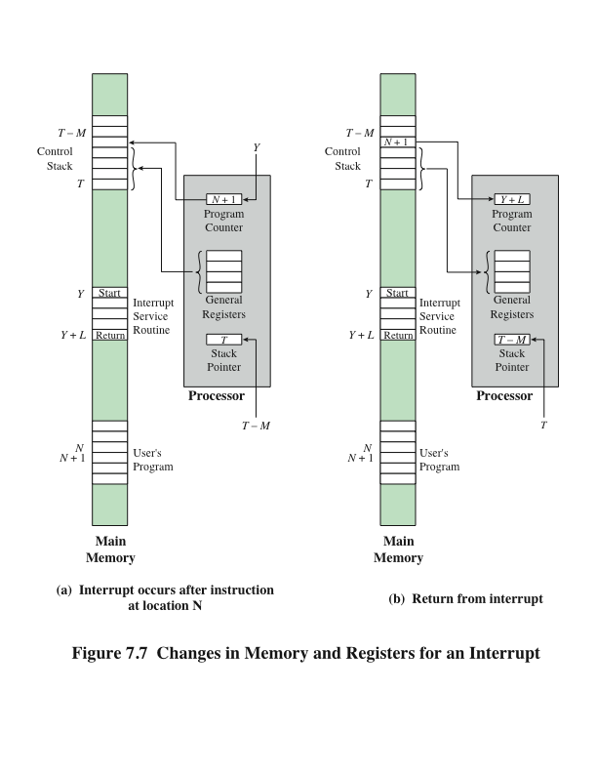
Changes in Memory and Registers for an
Interrupt
Notes:
Once the program counter has been loaded, the processor proceeds to the
next instruction cycle, which begins with an instruction fetch. Because the instruction
fetch is determined by the contents of the program counter, the result is that
control is transferred to the interrupt-handler program. The execution of this program
results in the following operations:
6. At this point, the program counter and PSW relating to the interrupted
program have been saved on the system stack. However, there is other information
that is considered part of the “state” of the executing program. In particular,
the contents of the processor registers need to be saved, because these
registers may be used by the interrupt handler. So, all of these values, plus any
other state information, need to be saved. Typically, the interrupt handler will
begin by saving the contents of all registers on the stack. Figure 7.7a shows a
simple example. In this case, a user program is interrupted after the instruction
at location N. The contents of all of the registers plus the address of the next
instruction (N + 1) are pushed onto the stack. The stack pointer is updated to
point to the new top of stack, and the program counter is updated to point to
the beginning of the interrupt service routine.
7. The interrupt handler next processes the interrupt. This includes an examination
of status information relating to the I/O operation or other event that
caused an interrupt. It may also involve sending additional commands or
acknowledgments to the I/O device.
8. When interrupt processing is complete, the saved register values are retrieved
from the stack and restored to the registers (e.g., see Figure 7.7b).
9. The final act is to restore the PSW and program counter values from the stack.
As a result, the next instruction to be executed will be from the previously
interrupted program.
Note that it is important to save all the state information about the interrupted
program for later resumption. This is because the interrupt is not a routine called
from the program. Rather, the interrupt can occur at any time and therefore at any
point in the execution of a user program. Its occurrence is unpredictable. Indeed, as
we will see in the next chapter, the two programs may not have anything in common
and may belong to two different users.

Slide 17
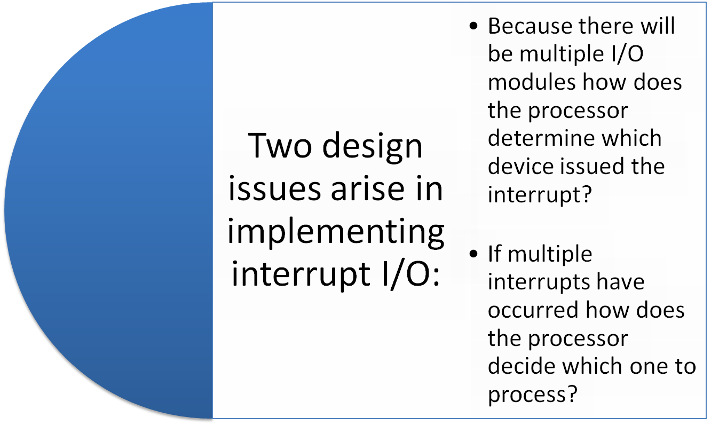
Design Issues
Notes:
Two design issues arise in implementing interrupt I/O. First, because there will
almost invariably be multiple I/O modules, how does the processor determine which
device issued the interrupt? And second, if multiple interrupts have occurred, how
does the processor decide which one to process?

Slide 18
Device Identification
Four general categories of techniques are in common use:
  Multiple interrupt lines
  Between the processor and the I/O modules
  Most straightforward approach to the problem
  Consequently even if multiple lines are used, it is likely that each line will have multiple I/O modules attached to it
  Software poll
  When processor detects an interrupt it branches to an interrupt-service routine whose job is to poll each I/O module to determine which module caused the interrupt
  Time consuming
  Daisy chain (hardware poll, vectored)
  The interrupt acknowledge line is daisy chained through the modules
  Vector – address of the I/O module or some other unique identifier
  Vectored interrupt – processor uses the vector as a pointer to the appropriate device-service routine, avoiding the need to execute a general interrupt-service routine first
  Bus arbitration (vectored)
  An I/O module must first gain control of the bus before it can raise the interrupt request line
  When the processor detects the interrupt it responds on the interrupt acknowledge line
  Then the requesting module places its vector on the data lines
Notes:
Let us consider device identification first. Four general categories of techniques
are in common use:
• Multiple interrupt lines
• Software poll
• Daisy chain (hardware poll, vectored)
• Bus arbitration (vectored)
The most straightforward approach to the problem is to provide multiple interrupt
lines between the processor and the I/O modules. However, it is impractical to
dedicate more than a few bus lines or processor pins to interrupt lines. Consequently,
even if multiple lines are used, it is likely that each line will have multiple I/O modules
attached to it. Thus, one of the other three techniques must be used on each line.
One alternative is the software poll. When the processor detects an interrupt,
it branches to an interrupt-service routine whose job it is to poll each I/O module
to determine which module caused the interrupt. The poll could be in the form of a
separate command line (e.g., TESTI/O). In this case, the processor raises TESTI/O
and places the address of a particular I/O module on the address lines. The I/O module
responds positively if it sets the interrupt. Alternatively, each I/O module could
contain an addressable status register. The processor then reads the status register
of each I/O module to identify the interrupting module. Once the correct module is
identified, the processor branches to a device-service routine specific to that device.
The disadvantage of the software poll is that it is time consuming. A more efficient
technique is to use a daisy chain, which provides, in effect, a hardware poll. An example
of a daisy-chain configuration is shown in Figure 3.30. For interrupts, all I/O modules
share a common interrupt request line. The interrupt acknowledge line is daisy chained
through the modules. When the processor senses an interrupt, it sends out an interrupt
acknowledge. This signal propagates through a series of I/O modules until it gets to a
requesting module. The requesting module typically responds by placing a word on
the data lines. This word is referred to as a vector and is either the address of the I/O
module or some other unique identifier. In either case, the processor uses the vector as
a pointer to the appropriate device-service routine. This avoids the need to execute a
general interrupt-service routine first. This technique is called a vectored interrupt.
There is another technique that makes use of vectored interrupts, and that is
bus arbitration. With bus arbitration, an I/O module must first gain control of the
bus before it can raise the interrupt request line. Thus, only one module can raise the
line at a time. When the processor detects the interrupt, it responds on the interrupt
acknowledge line. The requesting module then places its vector on the data lines.

Slide 19
Drawbacks of Programmed and Interrupt-Driven I/O
Both forms of I/O suffer from two inherent drawbacks:
  The I/O transfer rate is limited by the speed with which the processor can test and service a device
  The processor is tied up in managing an I/O transfer; a number of instructions must be executed for each I/O transfer
When large volumes of data are to be moved a more efficient technique is direct memory access (DMA)
Notes:
Interrupt-driven I/O, though more efficient than simple programmed I/O, still
requires the active intervention of the processor to transfer data between memory
and an I/O module, and any data transfer must traverse a path through the processor.
Thus, both these forms of I/O suffer from two inherent drawbacks:
1. The I/O transfer rate is limited by the speed with which the processor can test
and service a device.
2. The processor is tied up in managing an I/O transfer; a number of instructions
must be executed for each I/O transfer (e.g., Figure 7.5).
There is somewhat of a trade-off between these two drawbacks. Consider the
transfer of a block of data. Using simple programmed I/O, the processor is dedicated
to the task of I/O and can move data at a rather high rate, at the cost of doing
nothing else. Interrupt I/O frees up the processor to some extent at the expense of
the I/O transfer rate. Nevertheless, both methods have an adverse impact on both
processor activity and I/O transfer rate.
When large volumes of data are to be moved, a more efficient technique is
required: direct memory access (DMA).

Slide 20
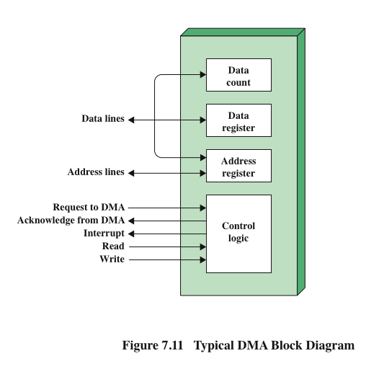
Typical DMA
Module Diagram
Notes:
DMA involves an additional module on the system bus. The DMA module
(Figure 7.11) is capable of mimicking the processor and, indeed, of taking over
control of the system from the processor. It needs to do this to transfer data to
and from memory over the system bus. For this purpose, the DMA module must
use the bus only when the processor does not need it, or it must force the processor
to suspend operation temporarily. The latter technique is more common and is
referred to as cycle stealing, because the DMA module in effect steals a bus cycle.
When the processor wishes to read or write a block of data, it issues a
command to the DMA module, by sending to the DMA module the following
information:
• Whether a read or write is requested, using the read or write control line
between the processor and the DMA module
• The address of the I/O device involved, communicated on the data lines
The starting location in memory to read from or write to, communicated on
the data lines and stored by the DMA module in its address register
• The number of words to be read or written, again communicated via the data
lines and stored in the data count register
The processor then continues with other work. It has delegated this I/O operation
to the DMA module. The DMA module transfers the entire block of data, one
word at a time, directly to or from memory, without going through the processor.
When the transfer is complete, the DMA module sends an interrupt signal to the
processor. Thus, the processor is involved only at the beginning and end of the
transfer (Figure 7.4c).

Slide 21
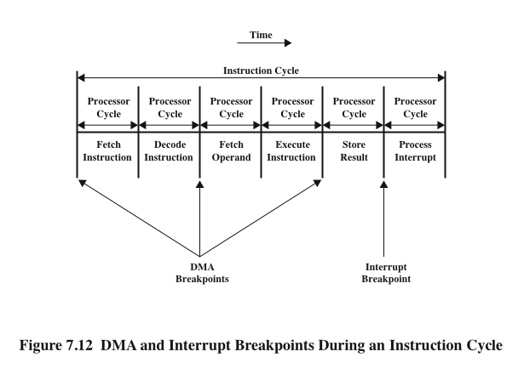
DMA Operation
DMA
DMA
Notes:
Figure 7.12 shows where in the instruction cycle the processor may be suspended.
In each case, the processor is suspended just before it needs to use the bus.
The DMA module then transfers one word and returns control to the processor.
Note that this is not an interrupt; the processor does not save a context and do
something else. Rather, the processor pauses for one bus cycle. The overall effect
is to cause the processor to execute more slowly. Nevertheless, for a multiple-word
I/O transfer, DMA is far more efficient than interrupt-driven or programmed I/O.

Slide 22
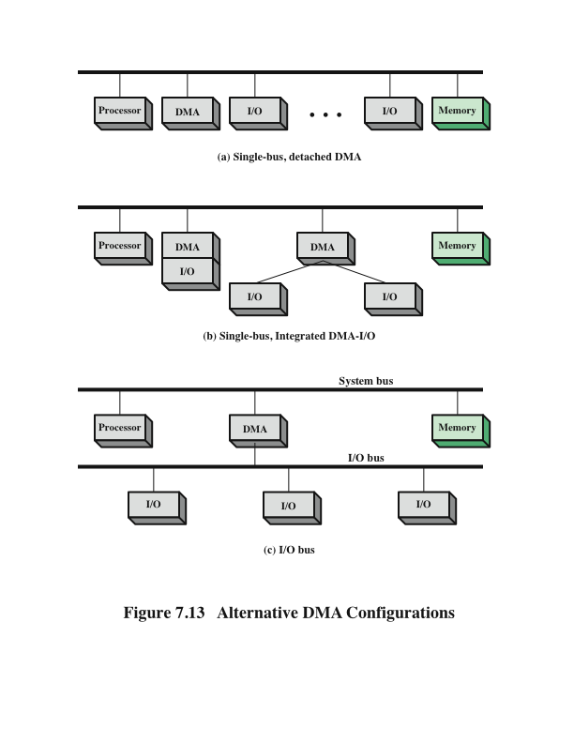
Alternative
DMA
Configurations
Notes:
The DMA mechanism can be configured in a variety of ways. Some possibilities
are shown in Figure 7.13. In the first example, all modules share the same system
bus. The DMA module, acting as a surrogate processor, uses programmed I/O to
exchange data between memory and an I/O module through the DMA module. This
configuration, while it may be inexpensive, is clearly inefficient. As with processor controlled
programmed I/O, each transfer of a word consumes two bus cycles.
The number of required bus cycles can be cut substantially by integrating the
DMA and I/O functions. As Figure 7.13b indicates, this means that there is a path
between the DMA module and one or more I/O modules that does not include the
system bus. The DMA logic may actually be a part of an I/O module, or it may be a
separate module that controls one or more I/O modules. This concept can be taken
one step further by connecting I/O modules to the DMA module using an I/O bus
(Figure 7.13c). This reduces the number of I/O interfaces in the DMA module to one
and provides for an easily expandable configuration. In both of these cases (Figures
7.13b and c), the system bus that the DMA module shares with the processor and
memory is used by the DMA module only to exchange data with memory. The
exchange of data between the DMA and I/O modules takes place off the system
bus.

Slide 23
Evolution of the I/O Function
The CPU directly controls a peripheral device.
A controller or I/O module is added. The CPU uses programmed I/O without interrupts.
Same configuration as in step 2 is used, but now interrupts are employed. The CPU need not spend time waiting for an I/O operation to be performed, thus increasing efficiency.
The I/O module is given direct access to memory via DMA. It can now move a block of data to or from memory without involving the CPU, except at the beginning and end of the transfer.
The I/O module is enhanced to become a processor in its own right, with a specialized instruction set tailored for I/O
The I/O module has a local memory of its own and is, in fact, a computer in its own right. With this architecture a large set of I/O devices can be controlled with minimal CPU involvement.
Notes:
As computer systems have evolved, there has been a pattern of increasing complexity
and sophistication of individual components. Nowhere is this more evident than
in the I/O function. We have already seen part of that evolution. The evolutionary
steps can be summarized as follows:
1. The CPU directly controls a peripheral device. This is seen in simple microprocessor-
controlled devices.
2. A controller or I/O module is added. The CPU uses programmed I/O without
interrupts. With this step, the CPU becomes somewhat divorced from the specific
details of external device interfaces.
3. The same configuration as in step 2 is used, but now interrupts are employed.
The CPU need not spend time waiting for an I/O operation to be performed,
thus increasing efficiency.
4. The I/O module is given direct access to memory via DMA. It can now move
a block of data to or from memory without involving the CPU, except at the
beginning and end of the transfer.
5. The I/O module is enhanced to become a processor in its own right, with a
specialized instruction set tailored for I/O. The CPU directs the I/O processor
to execute an I/O program in memory. The I/O processor fetches and executes
these instructions without CPU intervention. This allows the CPU to specify a
sequence of I/O activities and to be interrupted only when the entire sequence
has been performed.
6. The I/O module has a local memory of its own and is, in fact, a computer
in its own right. With this architecture, a large set of I/O devices can be
controlled, with minimal CPU involvement. A common use for such an
architecture has been to control communication with interactive terminals.
The I/O processor takes care of most of the tasks involved in controlling the
terminals.
As one proceeds along this evolutionary path, more and more of the I/O
function is performed without CPU involvement. The CPU is increasingly
relieved of I/O-related tasks, improving performance. With the last two steps
(5–6), a major change occurs with the introduction of the concept of an I/O module
capable of executing a program. For step 5, the I/O module is often referred
to as an I/O channel. For step 6, the term I/O processor is often used. However,
both terms are on occasion applied to both situations. In what follows, we will use
the term I/O channel.

Slide 24
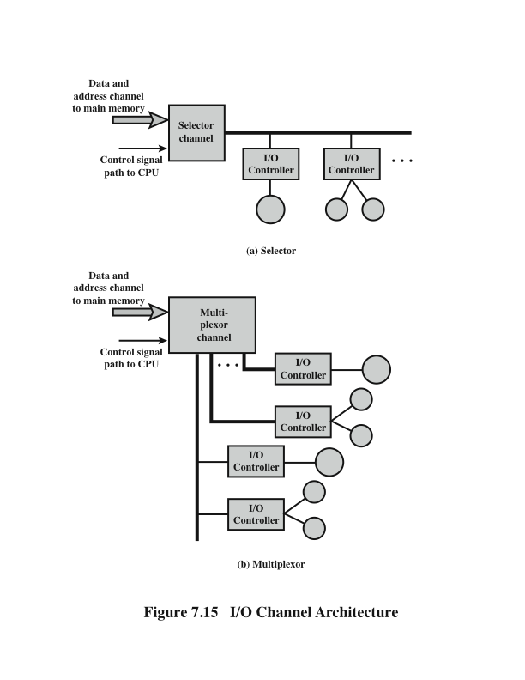
I/O
Channel Architecture
Notes:
The I/O channel represents an extension of the DMA concept. An I/O
channel has the ability to execute I/O instructions, which gives it complete control
over I/O operations. In a computer system with such devices, the CPU does
not execute I/O instructions. Such instructions are stored in main memory to
be executed by a special-purpose processor in the I/O channel itself. Thus, the
CPU initiates an I/O transfer by instructing the I/O channel to execute a program
in memory. The program will specify the device or devices, the area or
areas of memory for storage, priority, and actions to be taken for certain error
conditions. The I/O channel follows these instructions and controls the data
transfer.
Two types of I/O channels are common, as illustrated in Figure 7.15. A
selector channel controls multiple high-speed devices and, at any one time, is
dedicated to the transfer of data with one of those devices. Thus, the I/O channel
selects one device and effects the data transfer. Each device, or a small set of
devices, is handled by a controller, or I/O module, that is much like the I/O modules
we have been discussing. Thus, the I/O channel serves in place of the CPU in
controlling these I/O controllers. A multiplexor channel can handle I/O with multiple
devices at the same time. For low-speed devices, a byte multiplexor accepts or
transmits characters as fast as possible to multiple devices. For example, the resultant
character stream from three devices with different rates and individual streams
A₁A₂A₃A₄ …, B₁B₂B₃B₄ …, and C₁C₂C₃C₄ … might be A₁B₁C₁A₂C₂A₃B₂C₃A₄,
and so on. For high-speed devices, a block multiplexor interleaves blocks of data
from several devices.

Slide 25
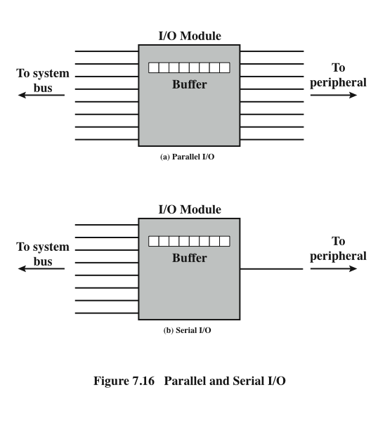
Parallel and
Serial
I/O
Notes:
The interface to a peripheral from an I/O module must be tailored to the nature
and operation of the peripheral. One major characteristic of the interface is whether
it is serial or parallel (Figure 7.16). In a parallel interface, there are multiple lines
connecting the I/O module and the peripheral, and multiple bits are transferred
simultaneously, just as all of the bits of a word are transferred simultaneously over
the data bus. In a serial interface, there is only one line used to transmit data, and
bits must be transmitted one at a time. A parallel interface has traditionally been
used for higher-speed peripherals, such as tape and disk, while the serial interface
has traditionally been used for printers and terminals. With a new generation of
high-speed serial interfaces, parallel interfaces are becoming much less common.

Slide 26
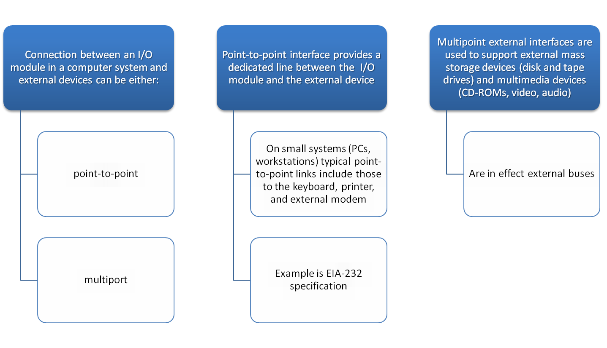
Point-to-Point and Multipoint Configurations
Notes:
The connection between an I/O module in a computer system and external devices
can be either point-to-point or multipoint. A point-to-point interface provides a
dedicated line between the I/O module and the external device. On small systems
(PCs, workstations), typical point-to-point links include those to the keyboard,
printer, and external modem. A typical example of such an interface is the EIA-232
specification (see [STAL11] for a description).
Of increasing importance are multipoint external interfaces, used to support
external mass storage devices (disk and tape drives) and multimedia devices
(CD-ROMs, video, audio). These multipoint interfaces are in effect external buses,
and they exhibit the same type of logic as the buses discussed in Chapter 3. In this
section, we look at two key examples: Thunderbolt and InfiniBand.

